Slide 1
Innovation in
The DoD

Slide 2
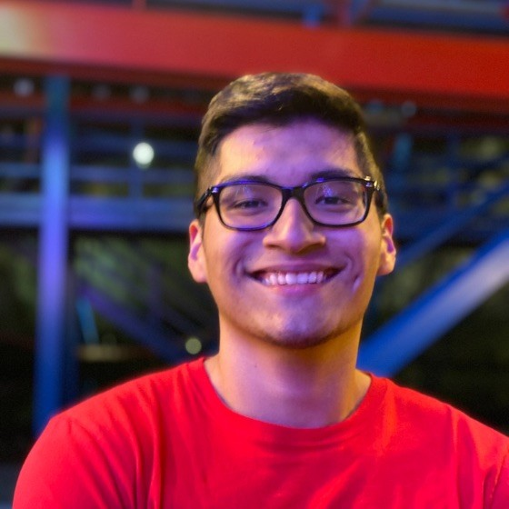
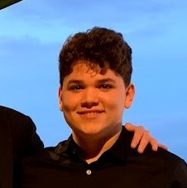

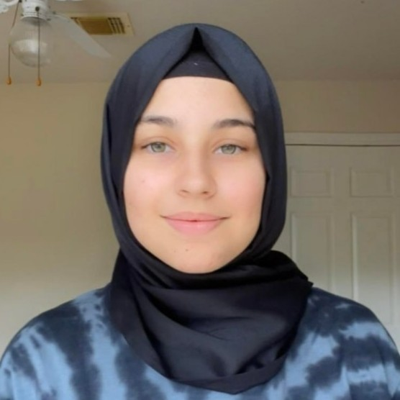
Meet our Team
Luis Alarcon CSCE 22’
Santana Gonzales
ITDE 23’
Juan Perez
ISEN 21’
Mualla Argin
CPSC 23’
Notes:
Hello, we are team #, and our names are: ….

Slide 3
Business Thesis
Our customer: Army Futures Command / Army Applications Laboratory (AAL)
Our product: A basket of metrics that reflect AAL’s value of contributions
ROI
Capability development
Changes to business culture
Growth of national security innovation base
Notes:
First, I will talk a little bit about our business thesis. our customer is …. our project sponsor is Scott Stanford. Next, our potential product is a... , including .... . I will pass it down to Luis, who is going to talk tou you guys about background research Juan P

Slide 4
Background Research
How is innovation measured?
Qualitative vs Quantitative
AAL has a lot of data gathered
Little feedback post project
Notes:
Look at doc(project description) and explain why you are making this project

Slide 5
Value Proposition
We will help AAL make better decisions based on data gathered pre, during and post project.
The DoD’s budget in 2020 was $714 billion.
Where does that money go? Was it spent well?
Our product will better communicate to the user where initial investment went and what it is valued at the end
Notes:
innovation, investment, and return on investment on a massive scale for AAL and their partners
https://www.boldbi.com/blog/data-visualization-importance-and-benefits

Slide 6

Project Design
Simple & Intuitive User Interface
Immediate access to relevant info
Notes:
Very simple because haven’t talked to sponsor. Python, pandas and friendly UI interface

Slide 7
Questions?

